Slide 1




Educational Opportunities
Notes:
Time Required: 75 min

Slide 2
Enabling Objectives
STATE the purpose of the United Services Military Apprenticeship Program (USMAP)
IDENTIFY the United States Navy Community College (USNCC) and its purpose
IDENTIFY the Navy College Program
DISCUSS Tuition Assistance (TA) and NCPACE eligibility requirements
IDENTIFY the MyNavy Education websites
DISCUSS VA Education and training benefits (GI Bill Program)
STATE the purpose of Navy Credentialing Opportunities Online (Navy COOL)
STATE the purpose of Defense Activity for Non-Traditional Education Support (DANTES)
LIST resources located within DoD MWR Libraries
DISCUSS the benefits of the Online Academic Skills Course
Notes:
FACILITATOR GUIDE:
Review objectives.

Slide 3
References
Navy Military Personnel Manual, NAVPERS 15560D
USMAP website at https://usmap.osd.mil/
United States Navy Community College (USNCC) at https://www.usncc.edu/
Navy College Program at https://www.navycollege.navy.mil/
MyNavyEducation http://myeducation.netc.navy.mil/webta/
Veterans Affairs website at https://www.va.gov/education
Navy Cool website at https://www.cool.osd.mil/usn/index.html
DANTES website at https://www.dantes.mil/
DoD MWR Libraries https://navy.dodmwrlibraries.org
MyNavyHR website at https://www.mynavyhr.navy.mil/
NAVADMIN 259/24: Selected Reserve Tuition Assistance Pilot Program Update
Notes:
FACILITATOR GUIDE:
Review references.

Slide 4

United Services Military Apprenticeship Program (USMAP)
A formal military training program that provides Service members the opportunity to improve their job skills and to complete their civilian apprenticeship requirements while in service.
Types of Apprenticeship:
Time Based- traditional model. It requires you to log 2,000 to 6,200 hours to complete.
Competency Based- for more experienced service members.
USMAP benefits:
Maximize earning potential
Gain workplace-relevant skills
Increased employability
Industry recognition
Documented work experience
Notes:
FACILITATOR GUIDE:
It is for all Active-duty enlisted member, including Selective Reserve or Guard that is on Active-Duty Orders for minimum of 12 months to participate in USMAP.
Additional Notes:
For time based, talk a little bit about the two components which is the Formal Classroom Instruction and OJT training. The First part is formal classroom instruction hours. The instruction may be classroom, technical schools, or other approved means. The Second part is On the Job training (OJT). This is the training at the place of work while doing the actual job. The hours must be completed and documented.
Experienced members may enroll in a Competency Based Apprenticeship which requires mastery of Competencies instead of documenting OJT hours.
Additional information for the USMAP program can be retrieved from the USMAP website.

Slide 5

United States Navy Community College (USNCC)
USNCC provides naval-relevant associate degrees and certificates to enlisted service members in the Navy, Marine Corps, & Coast Guard.
MISSION:
U.S. Naval Community College will advance warfighting advantage and enhance operational readiness by providing world class, naval-relevant education to a globally deployed force.
BENEFITS:
Separate from Tuition Assistance (TA) and Voluntary Education Program (VOLED)
You can earn stackable certificates on top of getting your associates degree
Coursework will be delivered online
Military friendly
Notes:
FACILITATOR GUIDE:
Visit the USNCC website for verify current information at https://www.usncc.edu/ prior to facilitating the lesson.

Slide 6

Navy College Program
$
VOLED
The Navy’s Voluntary Education program (VOLED) encompasses Tuition Assistance (TA) and the Navy College Program for Afloat College Education (NCPACE) which funds off-duty voluntary education.
NCPACE
Navy College Program for Afloat College Education (NCPACE) provides personnel assigned to Type 2 and 4 (sea duty) commands access to education opportunities.
NCVEC
Navy College Virtual Education Center (NCVEC) staffed by Navy College education counselors who provide information and education counseling services.
Fleet Engagement
Navy College Fleet Engagement Teams in CONUS to serve as the education advisor to Navy Installation Commanding Officers and Officers-in-Charge of Navy Activities and Units.
Notes:
FACILITATOR GUIDE:
The Navy College Program is 100% virtual and consist of the four primary areas VOLED, NCPACE, NCVEC, and Fleet Engagement.

Slide 7
Navy College Program (cont.)
WHAT IS Tuition Assistance (TA) and Navy College Program for Afloat College Education (NCPACE)?
TA is one of the Navy's primary financial assistance programs for voluntary education
NCPACE provide personnel assigned to sea duty type 2 and 4 commands with educational opportunity comparable to shore duty personnel
Both TA and NCPACE may be used for:
High School diploma
Associate degree
Bachelor's degree
Master's degree
Certificate programs
Notes:
FACILITATOR GUIDE:
Additional Notes:
1. TA provides funding to eligible active-duty Sailors for tuition costs of courses taken in an off-duty status at a college, university, or vocational/technical institution, who have a current, signed DoD VOLED Partnership MOU posted under the “Participating Institutions” tab, located at https://www.dodmou.com/. With the exception of Academic skills and high school completion courses, TA and NCPACE is only authorized for courses listed on the UEP or OEP.
2. Navy TA pays for independent study/distance learning courses taken via the NCPACE program.
· NOTE: There are no longer any instructor-led courses for the NCPACE program. It is 100% distance-learning.
3. Refer to OPNAV 1560.9B for official guidance or contact the NCVEC to verify if a specific program is eligible for Navy TA or NCPACE.

Slide 8
Navy College Program (cont.)
TA and NCPACE is limited to a lifetime cap of 120 semester hours, 180 quarter hours, 1800 clock hours (or combination). The lifetime credit cap applies to both TA and NCPACE combined
TA and NCPACE will be limited to a fiscal year cap of 18 semester hours, 27 quarter hours, or 270 clock hours (or combination).
Sailors may be enrolled in up to two courses which run concurrently. Required laboratory courses with unique course identification numbers are exempt from this limit.
Payment for TA will not exceed the following caps:
$250.00 per semester hour
$166.67 per quarter hour
$16.67 per clock hour (for approved certificate/diploma programs only)
Note: Always verify latest guidance as policies change.
Notes:
FACILITATOR GUIDE:
Always refer to the most recent NAVADMIN when briefing this slide and update as necessary.
Note the Following:
1.Tuition Assistance requests can be submitted as early as 120 days and must be command approved a minimum of 7 days preceding the course term start date.
2.Sailors may be enrolled in up to a maximum of two concurrent courses. Required laboratory courses with unique course identification numbers are exempt from this limit.
3.Ensure to follow your local command TA instruction (if applicable) & always refer to current NAVADMIN for recent changes in policy.

Slide 9
Navy College Program (cont.)
TA/NCPACE ELIGIBLITY REQUIREMENTS: OPNAVINST 1560.9B
Active component and Training and Administration of Reserve (TAR) enlisted Sailors with less than 16 years of service must have at least 6 months remaining to their End of Active Obligated Service (EAOS) or Soft End of Active obligated Service (SEAOS) from the official term start date.
Must have served in the Navy for a minimum of three years. There is NO waiver. (NAVADMIN 214/21).
Time-in-rate eligible Sailors must have taken and passed their most recent Navy-wide advance exam (NWAE)/Rating Knowledge Exam (RKE).
Pass most recent physical fitness assessment or have been medically waived.
Recommended for promotion with no trait marks below 3.0.
Note: Always verify latest guidance as policy may adjust
Notes:
FACILITATOR GUIDE:
These are some of the requirements. Always refer to the most recent NAVADMIN when briefing this slide and update as necessary.
Additional Notes:
1.Inform the class to refer to the current NAVADMIN for requirements for TA/NCPACE. The requirements listed are some but not all of the required eligibility requirements for TA/NCPACE.
2.Recommend before enrolling in school to receive education counseling from a Navy College Virtual Education Center Counselor to verify eligibility and submission deadlines.

Slide 10
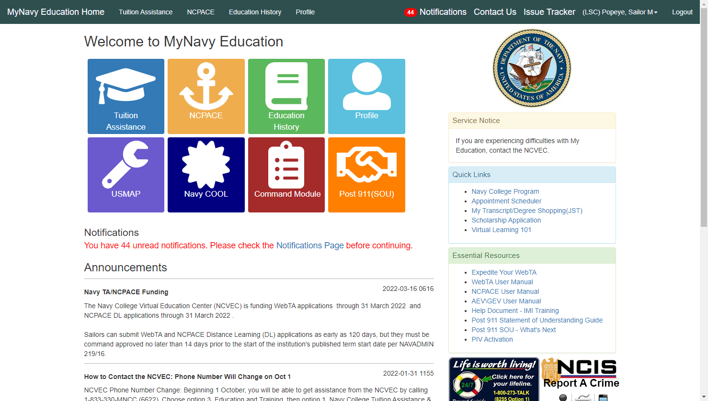
Navy College Program (cont.)
Use MyNavy Education portal to submit TA/NCPACE applications, print authorized vouchers, view education history and upload degree plans.
Notes:
FACILITATOR GUIDE:
1. Use this slide to show what the MyNavy Education homepage looks like.
2. Ensure to make note this is where Sailors go to submit their TA applications, sign the Statement of Understanding for Post/911, etc.

Slide 11
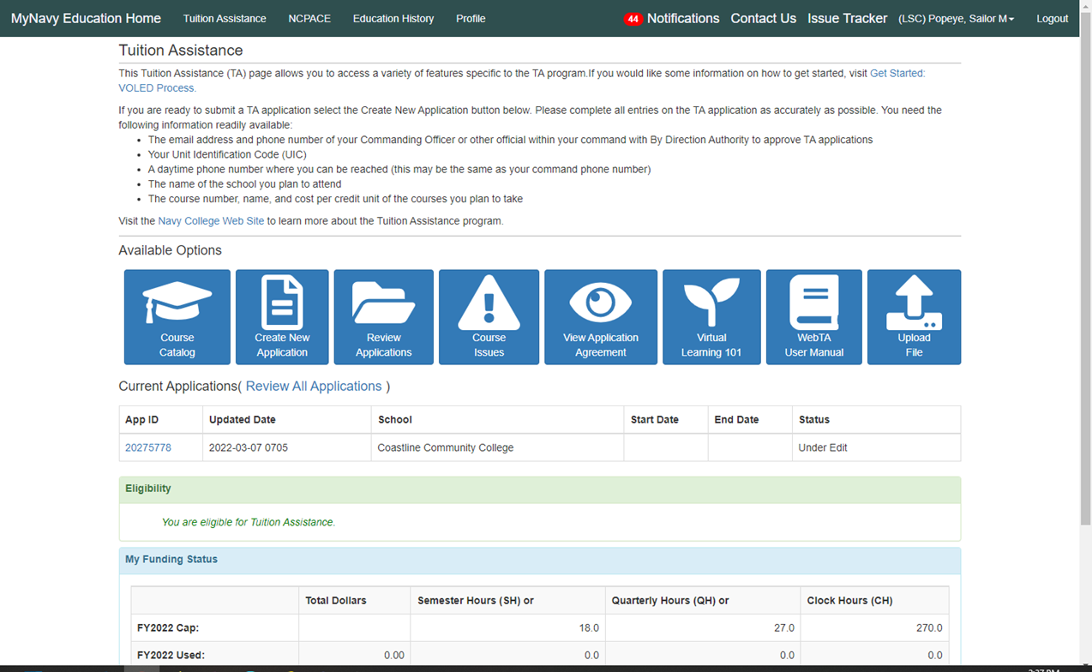
Navy College Program (cont.)
Notes:
FACILITATOR GUIDE:
Use this slide to point out how Sailors can track their TA eligibility, usage, complete the Virtual Learning 101 course, upload files, submit and review TA applications.

Slide 12
Navy College Program (cont.)
OTHER AVAILABLE EDUCATION PROGRAMS:
Advanced Education Voucher (AEV) - Enlisted
https://www.navycollege.navy.mil/common-resources/education-voucher-programs.htm
Graduate Education Voucher (GEV) - Officer
https://www.navycollege.navy.mil/common-resources/education-voucher-programs.htm?section=sr-gev
Graduate Certificate Programs
https://nps.edu/web/ddm/graduate-certificate-programs
Olmsted Foundation Scholar Program
https://olmstedfoundation.org/
Notes:
FACILITATOR GUIDE:
Slide is for informational purposes. Refer to Navy College website for more information or you may choose to research ahead of time and provide a short brief on each.
Additional Notes:
AEV: The Advance Education Voucher Program (AEV) enables selected senior enlisted personnel (E-7 to E-9) to obtain a Navy-relevant bachelor’s or master’s degree in designated areas of study through off-duty education at any U.S. Department of Education (DOE) accredited institution. The AEV program provides 100% funding for tuition, books, and related approved fees within guidelines and funding limits.
2. GEV: The Graduate Education Voucher program (GEV) was established to provide increased opportunity and incentive for selected Unrestricted Line (URL) officers who wish to obtain a master’s degree during off-duty hours. The GEV Program enables selected officers, with demonstrated superior performance and potential for future contributions to the Navy, to earn a Navy-relevant master’s degree leading to an approved subspecialty while meeting other Navy needs.
3. Graduate Certificate Programs offered at Navy Post Graduate School (NPS): The Department of Defense Management (DDM) offers a unique selection of specialized, high-quality, tailored graduate certificates focused on defense management. These certificate options are:
Offered to resident and distance learning students
Composed of a series of four to five courses
Taught by the highly qualified DDM faculty
4. Olmsted Foundation Scholar Program: The Olmsted Foundation Scholar Program provides select active duty officers serving in operational career fields with funding for two years of graduate study using a foreign language while providing overseas cultural and travel opportunities.

Slide 13
Navy College Program (cont.)
Resources and Point of Contact:
Navy College Program Website:
For more information about TA/NCPACE funding caps, please visit the NCP website at: https://www.navycollege.navy.mil
Navy College Virtual Education Center:
The NCVEC can be reached Monday through Friday from 0700-1900 EST.
Call 833-330-MNCC (6622).
Select option 3 “Education and Training”, then option 1 “Navy College, Tuition Assistance and Counseling.”
Notes:
FACILITATOR GUIDE:
Review contact information.

Slide 14

G.I. BILL (cont.)
The G.I. Bill is a series of programs that provides education and training benefits to eligible veterans and their families. Administered by the Department of Veterans Affairs (VA), programs help cover the costs of colleges, graduate school, vocational training and apprenticeships.
Montgomery GI Bill Active Duty (MGIB-AD)
Montgomery GI Bill Selected Reserve (MGIB-SR)
Post-9/11 GI Bill (Chapter 33)
Helpful resources:
Educational and career counseling
https://www.va.gov/careers-employment/education-and-career-counseling/
GI Bill Statement of Benefits
https://www.va.gov/education/about-gi-bill-benefits/
GI Bill Comparison Tool
https://www.va.gov/education/gi-bill-comparison-tool/
Notes:
FACILITATIOR GUIDE:
Visit the link below for the most up-to-date information regarding GI Bill Benefits prior to briefing the slide.
https://www.va.gov/education/about-gi-bill-benefits/
Main programs that we will focus on today:
MGIB-AD
MGIB-SR
Post-9/11 GI Bill - Authorized by Congress under Title 38 of the United States Code, Chapter 33. The Post-9/11 GI Bill provides financial support for education and housing to people with at least 90 days of continuous service after September 10, 2001, or individuals discharged with a service-connected disability after 30 days of continuous service after September 10, 2001.
Helpful Tools:
Educational and Career Counseling (VA Chapter 36) - Personalized Career Planning and Guidance (PCPG), or VA Chapter 36, offers free educational and career guidance, planning, and resources to Veterans and their dependents who are eligible for a VA education benefit. Find out how to apply for this program if you’re leaving active service soon or have been discharged within the past year. It is important to note that VA benefits are run by the VA, and there are VA representatives who are SME’s on VA benefits.
https://www.va.gov/careers-employment/education-and-career-counseling/
GI Bill Statement of Benefits will show you how much of your benefits you’ve used and how much you have left to use.
The GI Bill Comparison Tool can help you explore your options, and a VA accredited representative can help you apply for education benefits. This can also be a helpful tool for Sailors as they are deciding to select MGIB or Post-9/11 benefits, researching colleges and educational programs that they are interested in.

Slide 15
G.I. BILL (cont.)
Character of Discharge and Eligibility:
You must have received an HONORABLE discharge to be eligible for these programs:
Service Requirements:
Post-9/11 GI Bill:
Started service on or after September 11, 2001.
Served for at least 90 days total on active duty, or
Served for at least 30 days on active duty, without a break, and were honorably discharged with a service-connected disability, or received a Purple Heart
MGIB-AD:
The required service start date depends on certain factors, like when you served on active duty and whether your military pay decreased.
You must have served between 2 and 4 years. The minimum amount of time you must have served depends on other factors.
MGIB-SR:
Eligible service period after June 30, 1985 (Some types of training after September 30, 1990)
Agreed to serve 6 years in the Selected Reserve, or
Officer in the Selected Reserve agreed to serve 6 years in addition to initial service obligation.
Notes:
FACILITATOR GUIDE:
Visit the link below for the most up-to-date information regarding how your character of discharge affects your eligibility before briefing the slide.
https://www.va.gov/resources/compare-va-education-benefits/

Slide 16
G.I. BILL
(cont.)
Months of Benefits:
You may be eligible to get up to 36 months of benefits from one education program:
Post-9/11 GI Bill
MGIB-AD
MGIB-SR
You can use only 1 of these education benefits for a single period of service.
Note: In certain situations, you may be eligible for more than one education benefit. But you can only get a maximum of 48 months of combined education benefits. If you need help figuring out how many months of benefits you can get, contact VA for more information.
Notes:
FACILITATOR GUIDE:
Visit the link below for the most up-to-date information regarding how many months of each benefit before briefing the slide.
https://www.va.gov/resources/compare-va-education-benefits/

Slide 17
G.I. BILL
(cont.)
Post Separation time requirement to use benefits:
Post-9/11 GI Bill
If your last day on active duty was on or after January 1, 2013, you can use your benefits at any time. Your benefits won’t expire
If your last day on active duty was before January 1, 2013, you have 15 years from your last day on active duty to use your benefits
MGIB-AD
You have 10 years from your last day on active duty to use your benefits
MGIB-SR
You can use your benefits only while you’re serving in the Selected Reserve. Once you leave the Selected Reserve, you’re no longer eligible for education benefits under the MGIB-SR program.
Notes:
FACILITATOR GUIDE:
Visit the link below for the most up-to-date information regarding how much time you have to use benefits before briefing the slide.
https://www.va.gov/resources/compare-va-education-benefits/

Slide 18
G.I. BILL
(cont.)
Transfer of Education Benefits (TEB):
Requirements to transfer benefits:
Completed at least 6 years of service.
4 years remaining on contract at time of election.
The person receiving benefits is enrolled in the Defense Enrollment Eligibility Reporting System (DEERS).
Initiate Statement of Understanding (SOU) through MyNavy Education.
TEB request within 30 days of a 4 year reenlistment through MilConnect.
Members are responsible to verify status via MilConnect.
Approvals CANNOT be backdated.
Sailors who separate from active duty who transferred their education benefits, can still provide a future effective date for when the TEB can be used, change the number of months transferred, or revoke the TEB by submitting a written request to VA through MILCONNECT.
Notes:
FACILITATIOR GUIDE:
1. Visit the link below for the most up-to-date information regarding transferability prior to briefing the slide.
https://www.va.gov/education/transfer-post-9-11-gi-bill-benefits/
2. Dependents may be able to get money to pay for these expenses:
Tuition
Housing
Books and supplies
Fees for national standardized tests
Fees for licensing and certifications

Slide 19

Navy Credentialing Program (Navy COOL)
The Navy Credentialing program enables Navy personnel to earn civilian certifications and licenses that correspond to their Service occupations, academic degree, off duty training, reserve occupation, and prior-service credentialing.
Benefits of Navy COOL:
Every Navy rating and designator has at least one professional credential associated.
Certifications and licensing enhance your military career while creating future opportunities in the civilian employment sector.
Credentialing translates to greater rating knowledge, skills, competency, and personal fulfillment.
Industry-recognized credentials are often the key to a successful transition to civilian employment.
Notes:
FACILITATOR GUIDE:
Visit the Navy Cool website for the most up-to-date information prior to briefing the slide.
Additional Notes:
1. Navy Credentialing Opportunities On-Line (COOL) website that provides information on how Navy personnel can fulfill requirements for civilian credentials related to their ratings, designators, and jobs.
2. The Navy’s Credentialing Program Office funds exam vouchers for active and reserve Navy workforce.
3. MILGEARS powered by COOL helps Sailors through all phases of the career lifecycle to plan and achieve professional and personal goals by highlighting career possibilities and helping you visualize how to reach those goals.

Slide 20

Defense Activity for Non-Traditional Education Support (DANTES)​
DANTES provides education and career planning programs at no-cost to actively serving U.S. service members, supporting the Department of Defense’s (DoD) recruitment, retention, readiness, and transition efforts through lifelong learning and critical thinking.
More than ~123K sailors participate annually in Defense Education programs, helping them at every stage of their military career and into transition to the civilian workforce.
College and Career Planning
College Credit for Prior Learning
Education Support (CONUS & OCONUS)
Academic Credentials for Successful Transition
Notes:
FACILITATOR GUIDE:
Defense Activity for Non-Traditional Education Support (DANTES) provides education and career planning programs at no-cost to actively serving U.S. service members, supporting the Department of Defense’s (DoD) recruitment, retention, readiness, and transition efforts through lifelong learning and critical thinking.
More than ~123K sailors participate annually in Defense Education programs, helping them at every stage of their military career and into transition to the civilian workforce.
Overview:
Educational opportunities enabled by DANTES are a top reason why individuals join the military and why they stay.
DANTES promotes retention by providing access to education and professional development, enhancing career satisfaction and providing pathways for career advancement contributing to increased retention and long-term commitment to military service.
DANTES enhances readiness through skill development providing service members with access to higher education, equipping them with the knowledge and skills to adapt to evolving military requirements directly supporting operational readiness and performance.
DANTES supports transition by equipping service members with academic credentials, and skills that ease their transition to civilian life, enhancing employability.
Achieve Your Education and Career Path Planning Goals!
Prepare for College and Career Planning
ASVAB College Exploration Program
Kuder Journey College and Career Planning
College Comparison Tool (TA Decide)
Get College Credit for What You Already Know
Credit-by-Examination Program (CLEP and DSST)
Military Training Evaluation Program (MTEP)
Find Education Support
Contingency Overseas Education Support
Voluntary Education Enterprise Support
Transition Successfully
Navy Credentialing Program
DoD Transition Assistance Program
Education program references:
Kuder Journey’s College and Career Planning: Enables service member development using a customized online portal tailored to their needs and interests that support postsecondary education planning and assist with transitioning to the civilian workforce. (www.DANTES.mil/kuder/)
TA Decide College Comparison Tool: Department of Defense Memorandum of Understanding (DoD MOU) Program is a partnership between accredited academic institutions (AIs) and the DoD to help ensure service members are attending quality educational programs. The TA Decide College Comparison Tool resides under the DoD MOU homepage, allowing service members to view more than 2500+ Academic Institutions that meet stringent requirements, such as accreditation, eligibility to receive VA education benefits, and certification to accept federal financial aid. (www.dodmou.com)
Credit-by-Examination: Helps service members earn college credit for knowledge gained through previous experience and military training via the CLEP and DSST exams.
CLEP: Service members can choose from 34 CLEP exams, focusing on introductory level college course material. (www.DANTES.mil/CLEP/)
DSST: Service members can choose from 37 DSST exams, focusing on college subject exams such as Human Resource Management and Technology. (www.DANTES.mil/DSST/)
Military Training Evaluation: Through the Military Training Evaluation Program (MTEP), a service member's learning from military training, education, and occupational experiences is evaluated by the American Council on Education (ACE) and documented on the Joint Services Transcript (JST). (www.DANTES.mil/credit4training/)
Contingency Overseas Education Support: Provides service member access to postsecondary academic programs and services while deployed to the Central Command (CENTCOM) and Africa Command (AFRICOM) areas of responsibility (AOR). (www.DANTES.mil/oconus/)
Voluntary Education Enterprise Support: DANTES has an abundance of resources to help accelerate academic and career goals, save time and tuition costs. Visit www.DANTES.mil to learn about the Department’s Education Programs and Services, view FAQs and knowledge articles, download fact sheets and infographic, register for upcoming webinars, and explore test prep materials. Connect with DANTES on the web, Facebook, Instagram, LinkedIn, YouTube, MilEd Benefits Mobile App, and customer service email at dodhra-outreach-dantes@mail.mil.
Program update:
Academic Skills Training: As part of the Defense-wide topline reductions, DANTES is officially sunsetting the Academic Skills Training (AST) program on June 29, 2025. Sunset of the AST program includes termination of the Online Academic Skills Course (OASC), assessable both online and through the OASC mobile app. New registrations for the program were accepted through March 31, 2025. DANTES remains dedicated to delivering high-quality educational support programs to empower service members to achieve their academic goals. (www.DANTES.mil/OASC/)

Slide 21
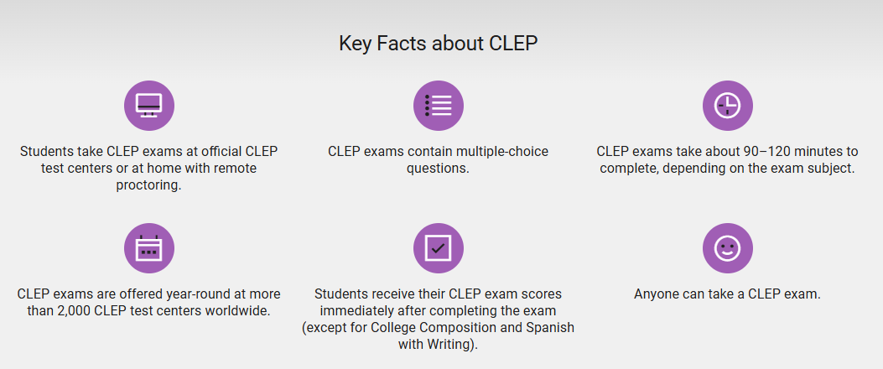

College Level Examination Program
(CLEP)
Notes:
FACILITATOR GUIDE:
1. Visit the link below for the most up-to-date information regarding CLEP and DSST prior to briefing the slide.
https://clep.collegeboard.org/
https://clep.collegeboard.org/register-for-an-exam/military-how-to-register-under-dantes
https://getcollegecredit.com/
CLEP
The College Level Examination Program (CLEP) is a series of 33 standardized subject exams that can be taken to earn recommended college credit for introductory-level classes - the kind most often taken in the first two years of college. Credits for successful scores on CLEP exams are accepted at more than 2,900 colleges and universities. For eligible military members, DANTES provides upfront funding of CLEP test fees for the first attempt on all exam titles.
Each year, nearly 50,000 military service members, as well as eligible spouses and civil service employees, take CLEP exams to reach their education goals. Because the exams are funded through the Defense Activity for Non-Traditional Education Support (DANTES), you could have your exam fee waived if you are eligible.
Visit https://clep.collegeboard.org/register-for-an-exam/military-how-to-register-under-dantes to learn how to determine eligibility, how to register for an exam, and testing locations (ONLINE PROCTORING IS NOW AVAILABLE).
ONLINE PROCTORING
Like DANTES funded test centers, the $30 remote proctoring fee for the first attempt at a CLEP exam is covered by DANTES. To take a CLEP exam with remote proctoring, you’ll first need to make sure you meet all technical and environment requirements, including a strong internet connection, a PC laptop or desktop computer, and a private room to test alone.
PRACTICE BEFORE THE EXAM
You're given the option to purchase an examination guide; however, after you identify as DANTES eligible in your account, the study guide for the exam you're purchasing will be automatically added to your account at no charge to you.
DSST
https://getcollegecredit.com/test-takers/active-duty-veteran/
The DSST (formerly DANTES Subject Standardized Tests) is a series of 37 standardized subject exams that can be taken to earn credit for introductory and upper level college courses. These exams are recommended for credit by the American Council on Education (ACE) and the credits are accepted at more than 1,900 institutions. For eligible military members, DANTES provides upfront funding of DSST test fees for the first attempt on all exam titles.

Slide 22


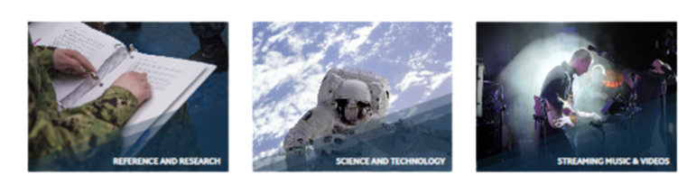


DoD MWR Libraries
Resources for Personal and Professional Growth
Notes:
FACILITATOR GUIDE: Visit the link below for the most up-to-date information regarding DOD MWR Libraries prior to briefing the slide.
https://www.dodmwrlibraries.org/
Because the internet is a popular and powerful tool for information access, education, and entertainment, the DoD joint service initiative is streamlining how MWR provides online access to library services and eResources - members can search for new library materials and upcoming programs at their local installation library; learn a new language; find a tutor; check out digital and audio books; these are just a few of the services to be offered in the new one-stop library shop.
DoD MWR Libraries, encouraging and empowering Service members and families to embrace life-long learning.
Biography and Genealogy
Ancestry
Ancestry offers access to billions of names from more than 4,000 genealogical databases. Censuses from the U.S., Canada, United Kingdom (U.K.) Ireland, and more than 150 million military records are available.
Ancestry
Ancestry offers access to billions of names from more than 4,000 genealogical databases. Censuses from the U.S., Canada, United Kingdom (U.K.) Ireland, and more than 150 million military records are available.
Fold3
Fold3 allows users access to US military records, including the stories, photos and personal documents of those who served from the Revolutionary War onward.
Gale In Context: Biography
Gale in Context: Biography offers access to thousands of both contemporary and historical biographies.
Children's Corner
BookFlix
Bookflix from Scholastic is a digital literacy resource that pairs classic video storybooks with related nonfiction titles to reinforce early reading skills and develop real-world knowledge.
Explora Educator's Edition
The Educator’s Edition of Explora highlights content relevant to teachers, including lessons plans, curriculum standards, and other professional development resources.
Gale In Context: Elementary
Gale In Context: Elementary provides a popular, child-friendly learning resource with a variety of subjects and an intuitive digital experience to that makes learning fun.
Gale In Context: Middle School
Gale In Context: Middle School combines the best reference content with age-appropriate videos, newspapers, and magazines.
Hiveclass
Hiveclass is the Digital Encyclopedia for youth sports training, a platform that makes it easy for families to access high quality, educational videos in various sports and activities. Whether a kid is exploring a new hobby, searching for additional instruction, or looking to increase levels of physical activity, Hiveclass provides various options for all.
Miss Humblebee's Academy
Miss Humblebee's Academy offers an award-winning curriculum that prepares children ages 3 to 6 for kindergarten proficiency.
National Geographic Kids
National Geographic Kids provides interactive science and archaeology learning resources for educators and children.
NoveList K-8 Plus
NoveList K-8 Plus is designed for younger readers and helps children find books that are just right for their reading level and interests.
ScienceFlix
ScienceFlix – (grades 4-10 with STEM Middle/HS focus) – Science for the Next Generation!
Teachables
Scholastic Teachables – (PreK – 6th Grade) Scholastic Teachables offers printable activities for any subject: math, science, reading comprehension, STEM, writing, and beyond. Download printable lesson plans, reading passages, games and puzzles, clip art, bulletin board ideas, teacher supports, and skills sheets. Over 25,000 teacher-created, vetted printables to support your instruction.
TrueFlix
TrueFlix – (grades 3-5) Bringing award-winning True Books to Life to help students master Social Studies and Science content knowledge through literacy!
Tutor.com
Tutor.com provides online tutoring and homework help for the U.S. military, Department of Defense staff and their families 24/7.
World Book Activity Corner
World Book Activity Corner provides thousands of fun, cost-effective, hands-on activities with easy instructions.
World Book Early Learning
World Book Early Learning is the perfect tool for young readers to explore with short videos, read-aloud stories, printable activities, and games kids love.
World Book Kids
World Book Kids provides ideal learning resources for elementary-aged students designed to build confidence and encourage creativity with image-driven and inquiry-based activities.
Continuing Education
BlueCareer
BlueCareer offers an easy-to-use resource center providing in-depth information on more than 100 skilled trades to match skilled tradespeople to hiring companies based on the experience & certifications the job demands.
EBSCO LearningExpress
EBSCO LearningExpress provides interactive tutorials, practice tests, e-books, flashcards and articles for academic skill-building, career advancement and standardized test preparation.
Gale OneFile: Vocations and Careers
Gale OneFile: Vocations and Careers provides guides, specialized industry journals, and educational information for career exploration.
Mango Languages
Mango Languages offers over 70 languages and provides the 6 critical skills for learning a new language: Vocabulary, Grammar, Pronunciation, Culture, Comprehension, and Retention.
Click the mobile icon near the top right corner of Mango Language site to find login credentials to access the mobile app.
O'Reilly
O’Reilly provides world class business and technology interactive trainings to individuals, teams, and businesses.
Universal Class
Universal Class: Over 600 online courseswith CEUs on almost any subject including: ComputerTraining, Personal Finance, How-To, Writing Skills, Pet and Animal Care, Professional Development, Health,Arts & Crafts, and so much more!
Wolfram Alpha
Compute answers using Wolfram's breakthrough technology & knowledge base, relied on by millions of students & professionals. For math, science, nutrition, history, geography, engineering, mathematics, linguistics, sports, finance, and music.
Note: Click on “Sign In” button at top right of WolframAlpha website after DoD authentication to complete the sign in process. No additional credentials are required to enter.
WolframAlpha App: Use the provided email address available under Account > Wolfram ID to login on the app.
World Book Student
World Book Student is an interactive encyclopedia that comes to life through this digital format and provides a one-stop shop for cross-curricular learning.
Do it Yourself
Chilton Library
Gale Chilton Library provides step-by-step automotive repair procedures. Includes manufacturer recommended maintenance schedules and recalls.
Gale Business: Entrepreneurship
Gale OneFile: Entrepreneurship provides more than 500 subject related, full-text periodicals.
Gale Business: Plan Builder
Gale Business: Plan Builder offers a successful step-by-step strategy for building a successful business.
Gale OneFile: Culinary Arts
Gale OneFile: Culinary Arts offers more than five million articles from more than 250 major cooking and nutrition magazines.
Gale OneFile: Gardening and Horticulture
Gale OneFile: Gardening and Horticulture serves horticultural enthusiasts of all levels with more than 3.6 million articles from more than 100 journals.
Gale OneFile: Home Improvement
Gale OneFile: Home Improvement has millions of articles with topics that include DIY projects, architectural techniques, and material selections.
Gale OneFile: Hospitality and Tourism
Gale OneFile: Hospitality and Tourism offers the curious traveler information about state parks, vacationing, and travel guides.
Small Engine Repair Source
Small Engine Repair Source provides over 400 reference books with original photos and illustrations for small engine repair assistance and detailed, user-friendly repair guides.
World Book Dramatic Learning
World Book Dramatic Learning provides a robust collection of popular plays with everything needed to put on a production.
eBooks and Audiobooks
EBSCO eBooks
EBSCO eBooks offers a variety of topics such as self-help, hobbies and cooking.
NoveList Plus
NoveList Plus has been helping readers find their next favorite book for more than 25 years and continues to develop innovative solutions for connecting readers, books, and libraries.
OverDrive Libby
OverDrive Libby provides access to eBooks, audiobooks and magazines. Best sellers and classics are included. For optimal user experience, download the Libby app onto your personal device.
World Book eBooks
World Book eBooks provides a digital library for all ages and reading levels. Find picture books, graphic novels, chapter books and classic titles.
Newspapers and Magazines
Digital Magazines
Digital Magazines is part of the OverDrive collection. Thousands of current and back issues are offered. Explore these resources from a mobile device with the Libby app.
Economist
Independent journalism providing in-depth global news and analysis. Our coverage spans world politics, business, tech, culture and more.
Foreign Policy
Foreign Policy (FP) provides a deep-dive on all things global affairs. FP explains the ins and outs of how foreign-policy decisions are being made – and, just as importantly, who is making them.
Gale OneFile: Popular Magazines
Gale OneFile: Popular Magazines provides access to the most circulated magazines in digital format.
National Geographic Magazine
National Geographic Magazine is an American monthly magazine published by the National Geographic Society best known for photojournalism.
PressReader
PressReader delivers digital access to over 7,000 full-text, full-page format newspapers and magazines from more than 120 countries in over 60 different languages. For app use: download the PressReader app before accessing link below.
Wall Street Journal
The Wall Street Journal provides breaking news and analysis from the U.S. and around the world.
World Book Advanced
World Book Advanced is a highly vetted, concise resource to check the facts. Live news feeds to world newspapers and primary source documents are included.
Reference and Research
Britannica Academic
Britannica Academic delivers fast and easy access to high-quality, comprehensive information on a variety of subjects.
Britannica ImageQuest
Britannica Image Quest provides educational imagery from over 50 leading collections. All images contain detailed descriptions and can be easily downloaded, printed, and emailed for use in your lessons or projects.
Britannica Library
Britannica Library is suitable for all ages and provides the educational community with content for class projects, test preps, and lesson plans.
Consumer Reports
Consumer Reports offers expert buying advice, ratings, reviews, and product descriptions.
Gale Academic OneFile
Gale Academic OneFile covers technology, medicine, engineering, arts, and literature and is considered a premier source for peer-reviewed, full-text scholarly content.
Gale General OneFile
Gale General OneFile provides a broad collection of news articles, magazines, books, academic journals, images and video that support general interest research and exploration.
Gale Health and Wellness
Gale Health and Wellness includes curated content on diseases and conditions; drugs; diagnostics and tests; and therapies, treatments, and surgeries.
Gale Legal Forms
Gale Legal Forms provides access to state-specific (and multi-state) legal documents, real estate contracts, wills, pre-marital agreements, bankruptcy, divorce, landlord-tenant and many others.
Gale OneFile: Agriculture
Gale OneFile: Agriculture has thousand of research articles that focus on the subjects of farming, agriculture, and food sustainability.
Gale OneFile: Business
Gale OneFile: Business provides full-text coverage of all business disciplines including accounting, economics, finance, marketing, management, and strategy, as well as business theory and practice.
Gale OneFile: Communications and Mass Media
Gale OneFile: Communications and Mass Media provides access to 400 journals on all aspects of the communications field, including advertising and public relations.
Gale OneFile: Criminal Justice
Gale OneFile: Criminal Justice makes research easy by bringing together information from more than 250 journals.
Gale OneFile: Economics and Theory
Gale OneFile: Economics and Theory provides access to academic journals and magazines focusing on topics in economics and related fields.
Gale OneFile: Entrepreneurship
Gale OneFile: Entrepreneurship provides more than 500 subject-appropriate, full-text periodicals.
Gale OneFile: Environmental Studies
Gale OneFile: Environmental Studies provides resources about environmental issues.
Gale OneFile: Fine Arts
Gale OneFile: Fine Arts places over 10 million articles for serious students of drama, music, art history, and filmmaking.
Gale OneFile: Insurance and Liability
Gale OneFile: Insurance & Liability connects researchers to leading journals such as Business Insurance, Employee Benefit News, National Underwriter Life & Health, and Risk Management.
Gale OneFile: Leadership and Management
Gale OneFile: Leadership and Management provides access to authoritative periodicals covering topics such as 21st-century skills, organizational dynamics, and continuing education.
Gale OneFile: Military and Intelligence
Gale OneFile: Military and Intelligence provides scholarly, peer-reviewed content covering current and historical military intelligence and strategy.
Gale OneFile: Nursing and Allied Health
Gale OneFile: Nursing and Allied Health serves the needs of nursing students and researchers in allied health fields who are looking for answers related patient care.
Gale OneFile: Physical Therapy and Sports Medicine
Gale OneFile: Physical Therapy and Sports Medicine is for researchers interested in the subjects of physical therapy, physical fitness, and sports medicine.
Gale OneFile: Pop Culture Collection
Gale OneFile: Pop Culture Collection provides access to scholarly journals and magazines for researchers in social science, history, art or liberal arts courses.
Gale OneFile: Psychology
Gale OneFile: Psychology provides access to authoritative periodical content supporting research in all fields of psychology.
Gale OneFile: Religion and Philosophy
Gale OneFile: Religion and Philosophy provides researchers with valuable insight about the impact of religions on cultures throughout history.
Gale OneFile: U.S. History
Gale OneFile: U.S. History is an engaging experience for those seeking contextual information on hundreds of the most significant people, events, and topics in U.S. history.
Gale OneFile: War and Terrorism
Gale OneFile: War and Terrorism provides researchers accessing the more than 1.7 million articles on the causes of war and the impacts of terrorism on a global scale.
Gale OneFile: World History
Gale OneFile: World History provides access to scholarly journals and magazines useful to both novice historians as well as advanced academic researchers.
Global Incident Map
Global Incident Map seeks to provide useful, timely, and relevant information on all manner of threats for situational awareness.
Morningstar Investing Center
Morningstar Investing Center provides access to information on mutual funds, stocks, investments, daily market news, and snapshot investments. Note: Access is only available from the DoD MWR Libraries website. Subscription does not include access on the Morningstar App.
National Geographic: People, Animals and the World
National Geographic: People, Animals, and the World includes interactive maps, fun to learn animal facts, and stories about the people who shape the world.
National Geographic Archive: 1888-1994
National Geographic Archive: 1888-1994 brings together a complete archive of National Geographic magazine along with a cross-searchable collection of National Geographic books, maps, images and videos.
Teacher Reference Center
Teacher Reference Center from EBSCO is a research database for teachers and education professionals and provides indexing and abstracts for more than 230 peer-reviewed journals.
Weiss Financial Ratings
Weiss Financial Ratings is the source for unbiased, accurate, trusted ratings that you can rely on to make sound, informed financial decisions.
World Book Discover
World Book Discover offers differentiated learners with access to content that improves reading comprehension skills and vocabulary building.
World Book Timelines
World Book TImelines provides a collection of 650 unique timelines, spanning the arts, science, culture, and more.
Science and Technology
Gale In Context: Science
Gale In Context: Science is updated daily and offers over 600 pages on topics across the curriculum, covering biology, chemistry, earth and environmental science, physics, and more.
Gale OneFile: Health and Medicine
Gale OneFile: Health and Medicine was created for students, consumer health researchers, and health care professionals that provides up-to-date information on the complete range of health care topics.
Gale OneFile: Information Science
Gale OneFile: Information Science is updated daily with articles covering all aspects of managing and maintaining information and technology, including usability, cataloging, circulation, and more.
Gale OneFile: Science
Gale OneFile: Science provides researchers with information on latest scientific developments in particle physics, advanced mathematics, nanotechnology, geology, and hundreds of other areas.
GreenFILE
GreenFILE from EBSCO offers well-researched information covering all aspects of human impact to the environment. Titles include content on global warming, green building, pollution, renewable energy, recycling, and more.
Streaming Music and Videos
Freegal
Freegal from Library Ideas LLC offers access to about 15 million songs and over 40,000 music videos.
Kanopy
Select from over 30,000 thousand award-winning films and documentaries available from Kanopy. Classic-films, world cinema, popular movies, plus a whole lot more educational and entertainment films to choose from. Access from anywhere, anytime, with any device.

Slide 23

EBSCO LearningExpress
Military Test Preparation
Aptitude Battery Test (ASVAB)
Aviation Selection Test Battery (ASTB)
Navy Advanced Programs Test (NAPT)
Skills Practice
Test Prep for College and Career exams
SAT, ACT, GRE, and career certification exams (nursing, real estate, law enforcement, civil service, etc.)
Computer Skills Training
Microsoft Office, Adobe, and general digital literacy
https://www.learningexpresshub.com
Notes:
FACILITATOR GUIDE: Visit the link below for the most up-to-date information regarding Tutor.com prior to briefing the slide. https://www.dodmwrlibraries.org/continuing-education
What’s Different?
The biggest difference between OASC and EBSCO LearningExpress is who they were designed for.
OASC was built specifically for military personnel, veterans, and their families, with a focus on core academic skills like reading, writing, and math. It seems to be primarily used to help with military advancement exams, entrance tests, or general academic improvement.
LearningExpress, on the other hand, is much broader. It was primarily designed for students, job seekers, and adult learners, offering test prep, career certification study guides, and job-related skills training. That said, it has quite a few military related options as well (at least via our DoD MWR Libraries account).
How Does the Course Content Compare?
Here’s what you had in OASC and whether you can find a replacement in LearningExpress:
Reading, Writing, and Math → YES in LearningExpress (under the Adult Core Skills center)
Study Skills & Critical Thinking → NOT a strong focus in LearningExpress
Military Entrance/Advancement Exam Prep → YES in LearningExpress (under the centers Active Military, National Guard and Reserve, Transitioning Military, and Military Families)
Self-Paced Learning → YES in LearningExpress, but structured differently
If OASC was used for…
Can LearningExpress replace it?
Improving reading, writing, and math Yes – LearningExpress has similar courses.
Preparing for military entrance/advancement exams Yes – LearningExpress has similar prep.
General academic skill-building Mostly – It has similar resources but lacks study skills training.
Career certification prep (nursing, civil service, etc.) Yes – LearningExpress actually offers more in this area.
Job search skills (resume writing, interviews, workplace skills) Yes – LearningExpress is stronger in career development.
Study skills and critical thinking No – LearningExpress doesn’t focus on this as much.
What LearningExpress Offers That OASC Didn’t
While LearningExpress may not be a perfect swap, it does seem to offer some things that OASC doesn’t:
Test Prep for College & Career Exams – Includes SAT, ACT, GRE, and career certification exams (nursing, real estate, law enforcement, civil service, etc.).
Job Search & Career Skills – Resume writing, interview tips, and workplace skills training.
Computer Skills Training – Tutorials for Microsoft Office, Adobe software, and general digital literacy.
For someone transitioning to a civilian career, LearningExpress could actually offer them more useful career-building tools than OASC ever did.

Slide 24
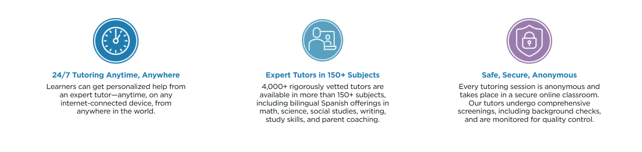

Tutor.com
Notes:
FACILITATOR GUIDE: Visit the link below for the most up-to-date information regarding Tutor.com prior to briefing the slide.
https://military.tutor.com/home
For U.S. Military and their families. No-cost, online tutoring and homework help, 24/7.
Tutor.com for U.S. Military Families, funded by the U.S. Department of Defense Morale, Welfare, and Recreation (MWR) General Library Program, and Coast Guard Mutual Assistance (CGMA), is a program that provides on-demand, online tutoring and homework help at no cost to eligible service members, civilian personnel, and their dependents. Those who fund the program determine eligibility for its use. Eligibility can change, and program availability is dependent upon available budget and is not guaranteed.

Slide 25
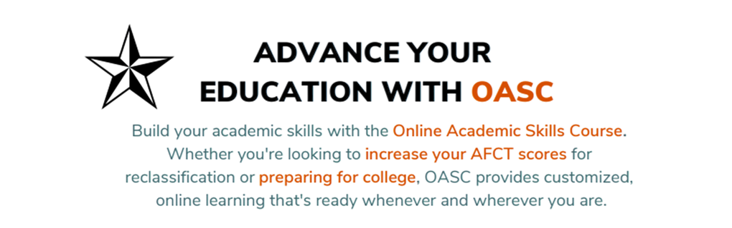

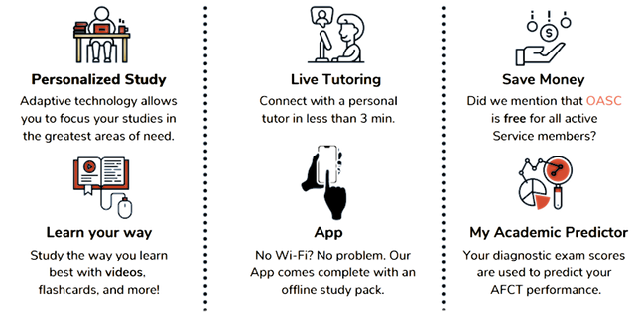
Online Academic Skills Course
(OASC)

Slide 26
Knowledge Check
What is the TA funding cap per fiscal year?
What is the lifetime credits allowed in a career?
Who can participate in the NCPACE program?
How long do Sailors have to use their Montgomery GI Bill after they separate from active duty? Post 9/11 GI Bill?
When are Sailors eligible to transfer their Post 9/11 GI Bill benefits to their spouse and children?
What are some benefits of the Navy Credentialing?
What are some benefits of DANTES?
What types of tests will EBSCO Learning help Sailors study for?
Notes:
ANSWERS:
TA and NCPACE will be limited to a fiscal year cap of 18 semester hours, 27 quarter hours, or 270 clock hours (or combination). The fiscal year cap applies to both TA and NCPACE combined
120 credit hours
Sailors assigned to Type 2 and Type 4 UICs
10 years
After serving 6 years active duty and reenlisting for at least 4 more years
Program allows institutions of higher learning to voluntarily enter into an agreement with the VA to fund tuition and fee expenses that exceed the tuition and fee amounts payable under the Post-9/11 GI Bill.

Slide 27
Summary and Review
United Services Military Apprenticeship Program (USMAP)
United States Navy Community College (USNCC)
Navy College Program
Tuition Assistance (TA) and NCPACE eligibility requirements
MyNavy Education
VA Education & Training Benefits (GI Bill Program, TEB)
Navy Credentialing Opportunities Online (Navy COOL)
DANTES
DoD MWR Libraries

Slide 28
Questions?

